Slide 1
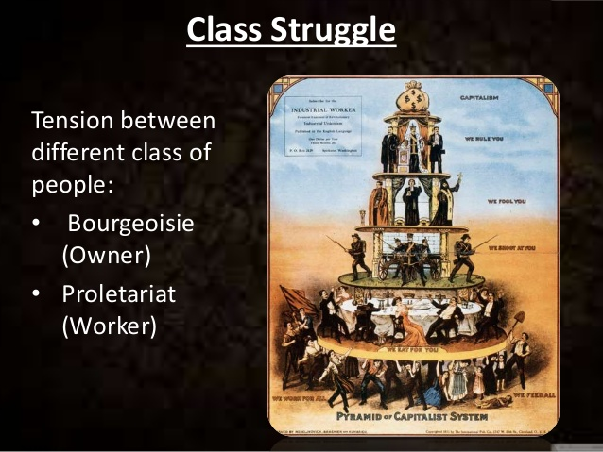
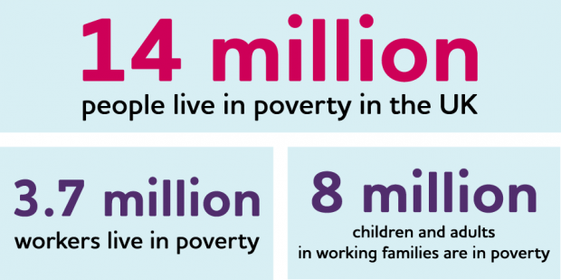
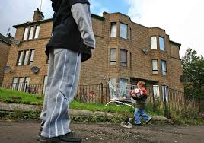
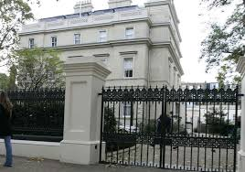
Poverty and Inequality
Week 5 Part 1

Slide 2
Learning outcome
To understand what poverty is?
To discuss social inequality?
Why is this an issue?
Social stratification and class
Income and wealth – inequality
Poverty and inequality
Link this to recent data showing who is affected by Covid -19

Slide 3
Activity
Can you explain what poverty is using your own simple words?
Do you know how we measure this?

Slide 4
Poverty – what is it?
Poverty is defined relative to the standards of living in a society at a specific time.
People live in poverty when they are denied an income sufficient for their material needs and when these circumstances exclude them from taking part in activities which are an accepted part of daily life in that society.“
Scottish Poverty Information Unit The most commonly used way to measure poverty is based on incomes. A person is considered poor if his or her income level falls below some minimum level necessary to meet basic needs. This minimum level is usually called the "poverty line".
The World Bank Organisation
Notes:
Poverty is defined relative to the standards of living in a society at a specific time.
People live in poverty when they are denied an income sufficient for their material needs and when these circumstances exclude them from taking part in activities which are an accepted part of daily life in that society." Scottish Poverty Information Unit The most commonly used way to measure poverty is based on incomes. A person is considered poor if his or her income level falls below some minimum level necessary to meet basic needs. This minimum level is usually called the "poverty line".
What is necessary to satisfy basic needs varies across time and societies. Therefore, poverty lines vary in time and place, and each country uses lines which are appropriate to its level of development, societal norms and values."

Slide 5
Poverty continued
The current National Minimum Wage, which was introduced by Labour in 1998, is £8.20 an hour for those 21 years of age and older. For 18- to 21-year-olds it is £6.45 and for under-18s it is £4.55. For apprentices £4.15 an hour (GOV.UK 2020)
Why is this an issue? – This law has been aimed to remove poverty in long term as a result of that we can see that there is a constant growth in the National Minimum Wage.
There is no differentiation across the country for the minimum wage. Employers can pay their workers the same in London as in Newcastle.
Paying the "living wage" is entirely optional. Employers are required to pay the minimum wage, but they need pay no more – as some workers cannot live off it.
Notes:
Tony Blair promised to halve child poverty in UK by 50% by 2010 and eradicate it by 2020
Creation of Sure Start centres. Reduction of children on the breadline a key aspect of his second term in office

Slide 6
Poverty continued …….
"There are basically three current definitions of poverty in common usage: absolute poverty, relative poverty and social exclusion.
Absolute poverty is defined as the lack of sufficient resources with which to keep body and soul together.
Relative poverty defines income or resources in relation to the average. It is concerned with the absence of the material needs to participate fully in accepted daily life.

Slide 7
continued
Social exclusion is a new term used by the Government. The Prime Minister described social exclusion as " shorthand label for what can happen when individuals or areas suffer from a combination of linked problems such as unemployment, poor skills, low incomes, poor housing, high crime environments, bad health and family breakdown".
“The correlation between supermarket size and national obesity prevalence”
Notes:
Social exclusion – subjective to the society in which people live and can vary over time and across countries

Slide 8
What do you think?
what is the difference between equality and equity?

Slide 9
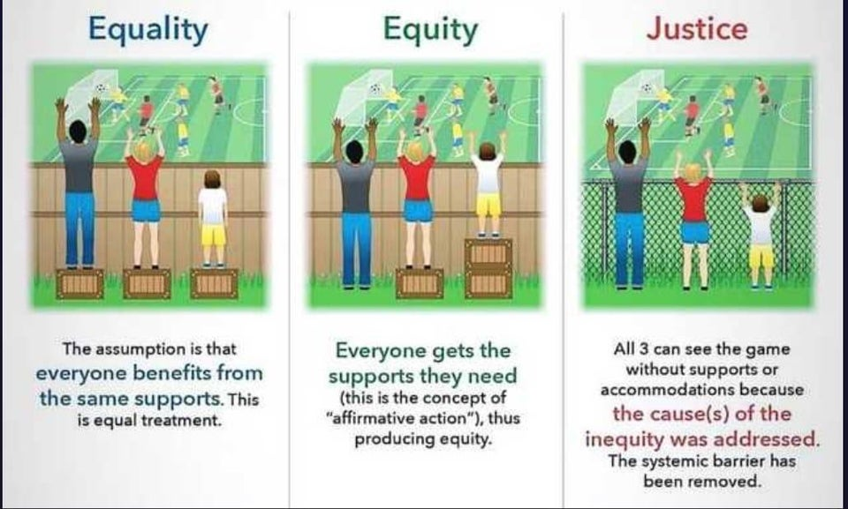

Slide 10
Social Inequality – what is it?
Inequality is an unfair situation in which some people have more rights or better opportunities than other people (Merriam-webster.com 2019)
Therefore:
Social inequality is the existence of unequal opportunities and rewards for different social positions or statuses within a group or society.
Social inequality is the extent to which there are differences between groups in society. Social inequality can be related to:
Age
Gender
Race
Social environment – child protection issues linked to post codes
Disabilities and Health Issues

Slide 11
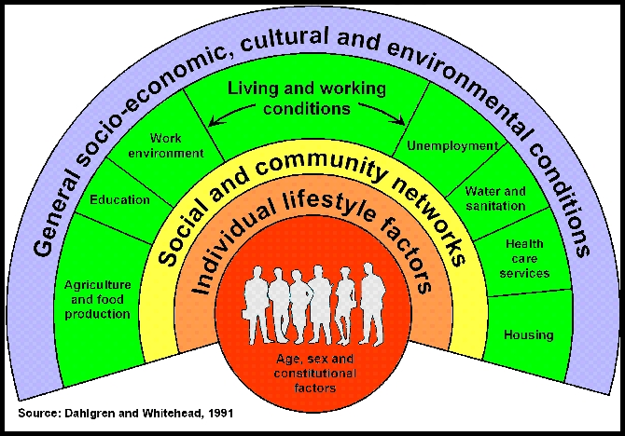
What do you see here?

Slide 12
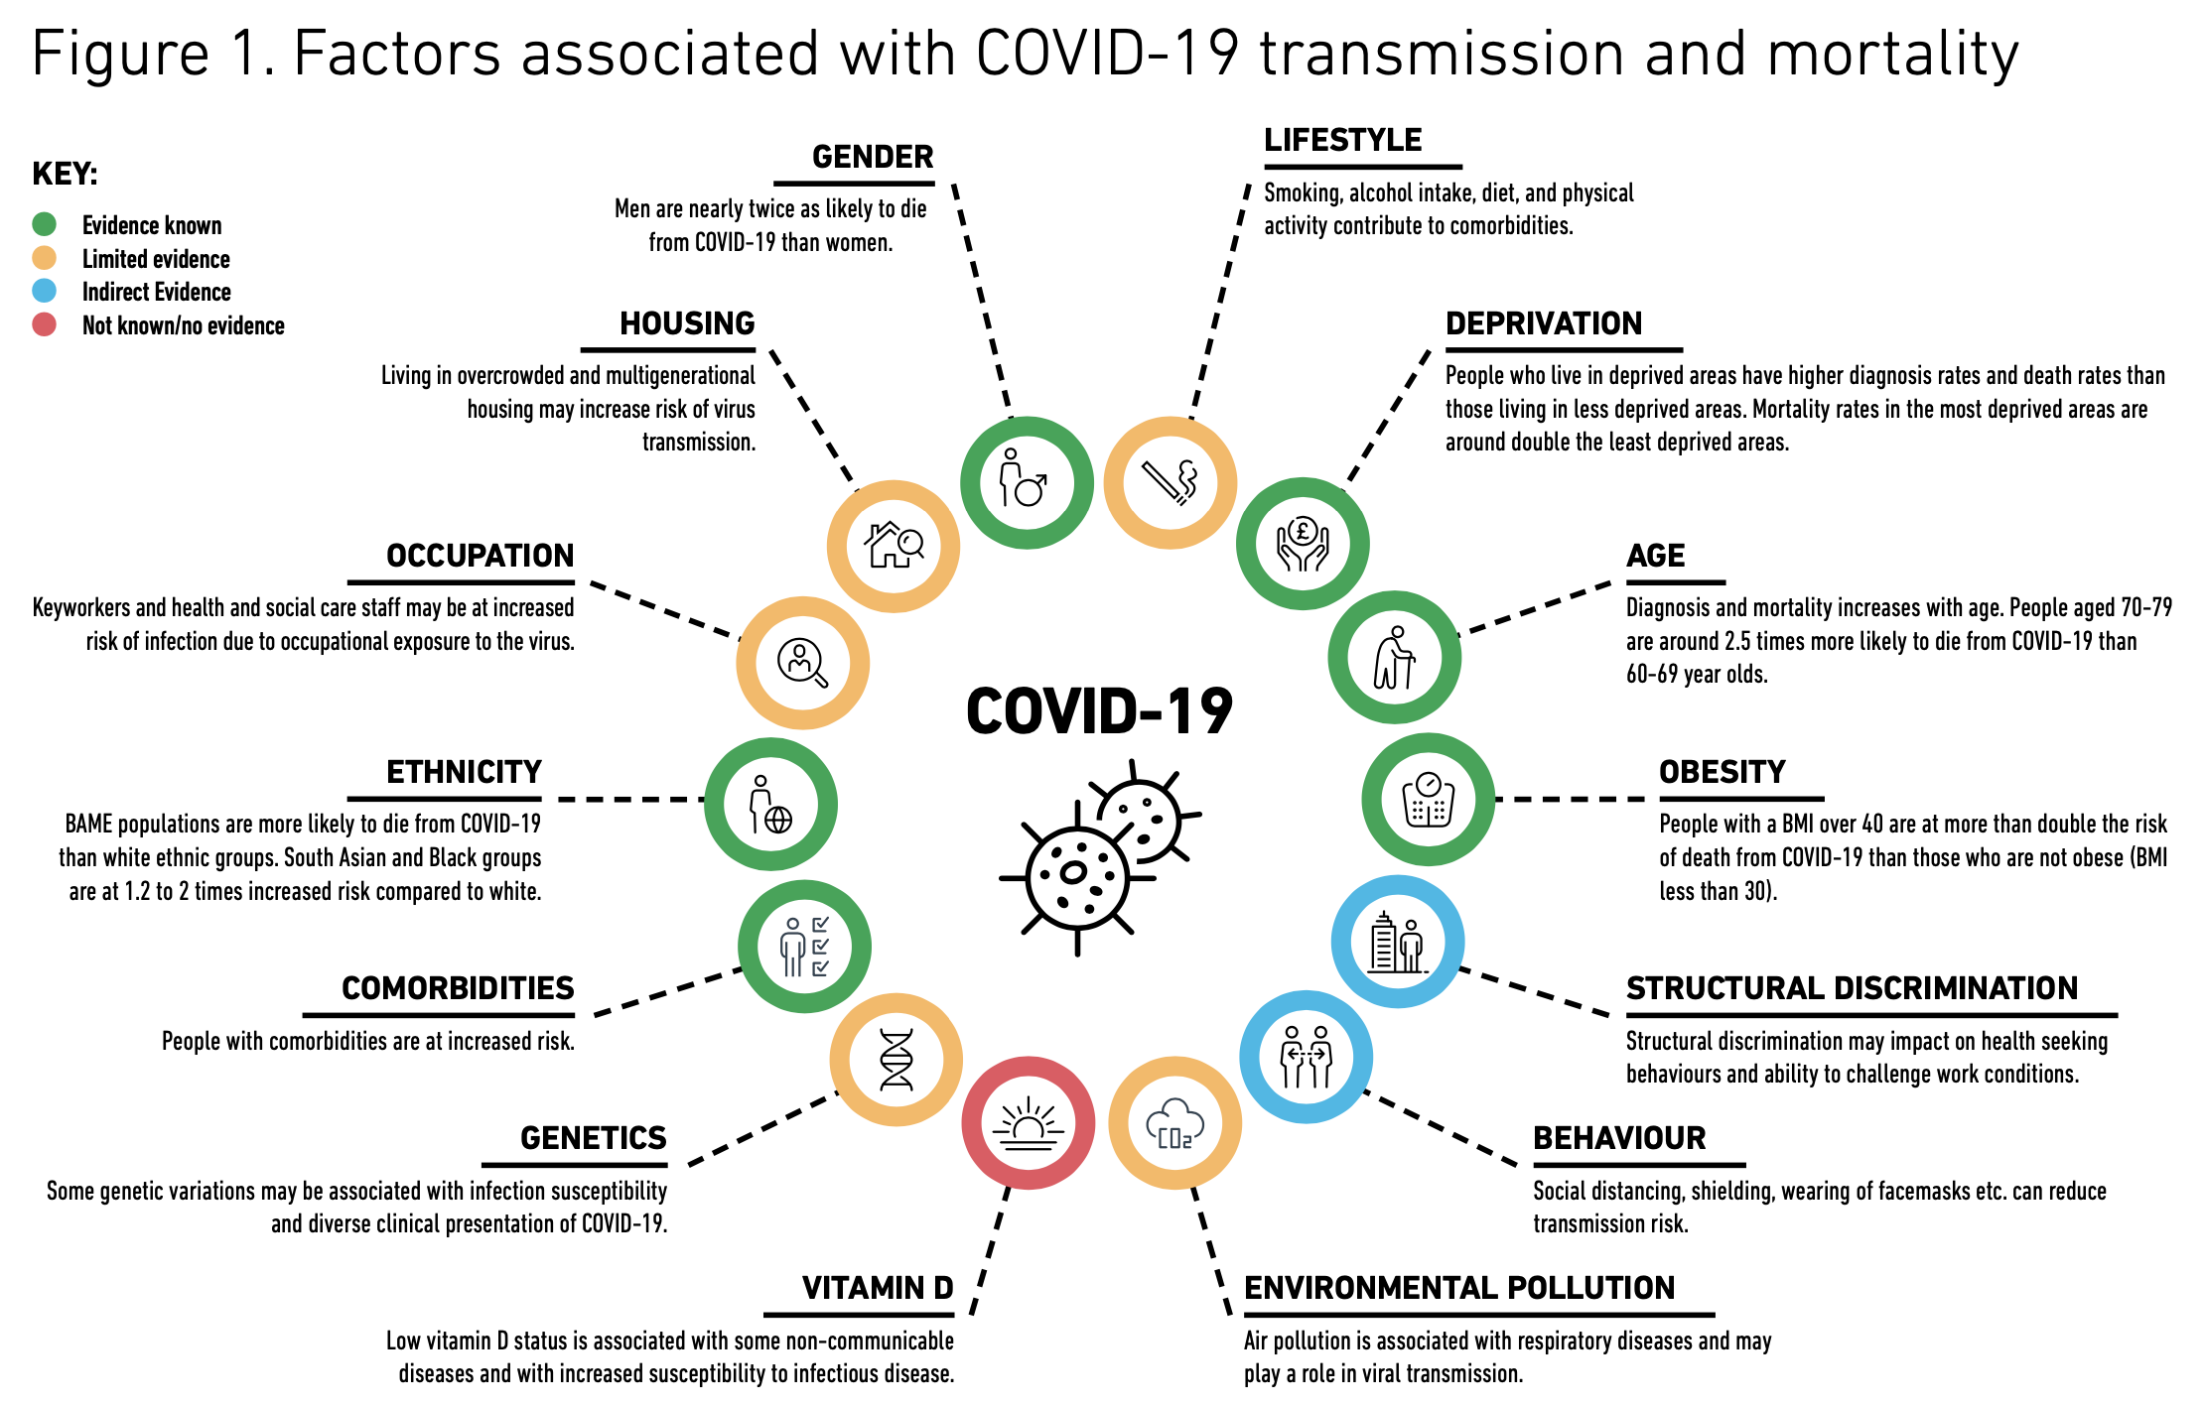
COVID-19 in Black, Asian and Minority Ethnic populations: An evidence review and recommendations from SAHF (2020).
Available at: https://www.sahf.org.uk/covid19

Slide 13
Why is this important in contemporary society?
Britain 21st Century
Wide range of inequalities exist between different social groups in contemporary society
For example, the gap between the rich and the poor, men and women, old and the young etc
Depending on wealth, gender and age depends on likelihood of getting a good education and job, maintaining our health it is easier for those with money to join gym and other leisure opportunities
Education – literacy levels higher in wealthy
Power – influence of society easier for rich

Slide 14
What are the consequences of social inequality?
High number social issues such as teenage pregnancy, crime, mental illness, obesity, unemployment
Poor less likely to seek help with depression because they are unemployed, less likely to be able to join a gym so become obese, if they commit crime more likely to receive harsher punishment
Further increase in social issues in society
Greater divisions between social groups
More conflict between social groups/society
Dealing with diseases … Covid-19

Slide 15
Health inequality and Covid-19
Are we respecting ethnic or national differences in UK?
BAME face inequalities in range of factors, such as housing conditions, environment, immigration status, access to information, income inequality and general levels of stress, are more likely to experience poorer physical and mental health and suffer more adversely as a consequence
Despite making up just 13% of the UK population, over 35% of all patients critically ill with COVID-19 were from Black, Asian and Minority Ethnic (BAME) backgrounds

Slide 16
Health inequality and Covid-19
There are many reasons for this:
Poor and cramped occupation housing conditions and higher in BAME
Disproportionately high conditions that increase vulnerability to the Covid-19, such as diabetes and heart disease
Working in occupations, such as the care sector, transport and food retail and therefore an increased risk of infection

Slide 17
COVID Response: BAME assessments
Key headlines:
Among people already diagnosed with COVID19, people who were 80 or older were seventy times more likely to die than those under 40.
Risk of dying among those diagnosed with COVID19 was also higher in males than females; higher in those living in the more deprived areas than those living in the least deprived; and higher in those in Black, Asian and Minority Ethnic (BAME) groups than in White ethnic
People of Bangladeshi ethnicity had around twice the risk of death when compared to people of White British ethnicity.
People of Chinese, Indian, Pakistani, Other Asian, Caribbean and Other Black ethnicity had between 10 and 50% higher risk of death when compared to White British

Slide 18
People from BAME backgrounds are more likely to be exposed to C-19 & have increased vulnerability for a number of reasons
Structural inequality (systematic disadvantage/discrimination/racism)
e.g. housing, occupation, income, access to healthcare, education etc
Biological factors
genetic susceptibility?
vitamin D status
higher prevalence of cardiometabolic disease (CVD, obesity, type 2 diabetes)
Behavioural factors
adherence to advice on social distancing, isolating etc (no evidence base)
importance of access to culturally & language appropriate information & resources
health-related e.g. physical activity, diet
cultural or religious concerns e.g. fatalistic beliefs, use of alcohol containing hand gels
All the above are impacted by social determinants of health

Slide 19
Occupation & Exposure to Covid-19
BAME people are overrepresented in key worker
many roles with lower pay ⎱
less secure employment (zero hour contracts) ⎰
difficult to work from home or socially distance
social determinants of health

Slide 20
A greater proportion of BAME health and care workers have died from COVID-19 than would be expected
In the NHS, BAME individuals represent around 21% of all staff
20% of nursing and support staff
44% of medical staff (doctors and dentists)
Overall, mortality from Covid-19 has been lower in frontline healthcare staff than in the general population
But,
76% of deaths in healthcare workers were in people from BAME groups

Slide 21
Survey evidence from the Royal College of Nursing
66% of White British nurses self-report receiving a sufficient level of eye and face PPE
43% of BAME nurses report receiving sufficient PPE
49% of BAME nurses report having been asked to reuse single use PPE
Vs. 37% of White British nursing staff reporting the same
clear inequalities in perceptions over the provision of PPE training between BAME and White British nurses
BAME healthcare workers may feel less able to speak out against lack of appropriate PPE or exposed working conditions

Slide 22
References
Bellamy, R. (2008) Citizenship: A very short introduction, Oxford, Oxford University Press.
Browne, K. (2011) An Introduction to sociology, (4th edn) Cambridge, Polity Press.
Giddens, A & Sutton, P.W. (2017) Essential concepts in sociology, (2nd edn), Cambridge, Polity Press.
Google Images (2019)Karl Marx available at: https://www.google.com/search?q=social+stratification&tbm=isch&tbs=rimg:CQEgz7M-VK8HIji8WcH2RvYFC9Ss1FlFVlt5irWl2-3I_1EZNbD5_1UCPlYj_1BDA97dCsx6sHsDt7tJmIcPU4FwQa_1FioSCbxZwfZG9gULEZYHjEScsC_1UKhIJ1KzUWUVWW3kR-ZnU2gV-CGMqEgmKtaXb7cj8RhHdFcPC9sHldyoSCU1sPn9QI-ViEVyp5lR2YsjXKhIJP8EMD3t0KzERRzk9yY0XLVMqEgnqwewO3u0mYhEwoFM8d_1CtdSoSCRw9TgXBBr8WEc_1y2UxyL5Zv&tbo=u&sa=X&ved=2ahUKEwj-0MqbpbbhAhVnyoUKHWwoApkQ9C96BAgBEBs&biw=1536&bih=706&dpr=1.25#imgrc=6sHsDt7tJmL_QM:

Slide 23
Google Images (2019) Max Weber available at: https://www.google.com/search?biw=1536&bih=706&tbm=isch&sa=1&ei=n-SlXKiiAY2H1fAP0oid6A4&q=max+weber+social+stratification&oq=weber+social+stratification&gs_l=img.1.0.0i5i30.214081.215565..217962...0.0..0.66.337.6....1..1....1..gws-wiz-img.......0i7i30j0i7i5i30.CVWiupvUUK8#imgrc=R3GX7eHACp06wM:
GOV.UK (2020) https://www.gov.uk/government/publications/the-national-minimum-wage-in-2020

